Slide 1
Time Series Forecasting Part 1
Nakul Bajaj

Slide 2

What is Forecasting?
Ability to see the future
Ability to predict the future
Ability to guess the future
b. Ability to predict the future

Slide 3
Forecasting Usecases
Will it rain tomorrow
How many people are likely to get vaccinated tomorrow
Will the house prices rise in the future
Will the fuel get more expensive in the future
Many more…

Slide 4
Forecasting In Institutional Data Analytics
How many people are likely to make a purchase next month
Inventory planning
Operations planning
Marketing planning
How much cash on hand will I have so I am able to operate my business successfully -> Will I need help from the bank?
How much cash client is likely to have, so they can run their business successfully -> Can we , the bank offer a product to help the client?

Slide 5
Key Concepts
Seasonality Vs Cyclicity
Trend
Lags
Correlation
Causation

Slide 6
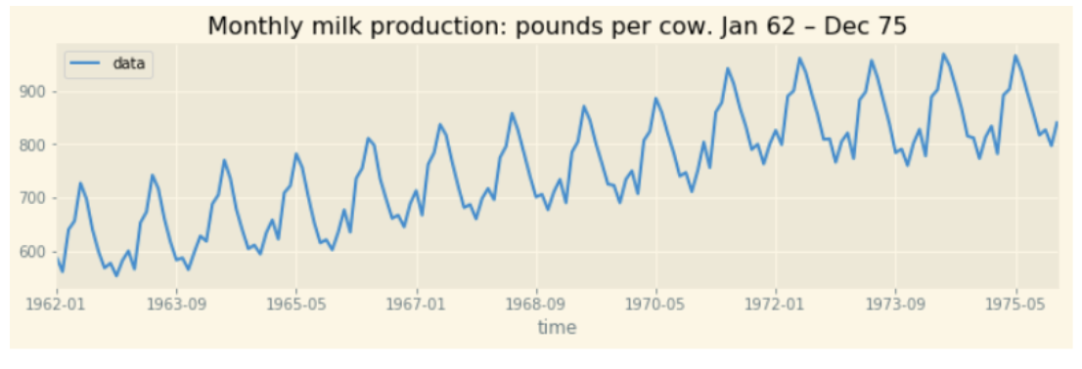
What is Seasonality
Seasonality is a characteristic of a time series in which the data experiences regular and predictable changes that recur every calendar year. Any predictable fluctuation or pattern that recurs or repeats over a one-year period is said to be seasonal.

Slide 7
What is Cyclicity
Opposite to seasonality. Because the trend repeats itself in different time periods rather than fixed time period

Slide 8
What is a trend
Trend is a pattern in data that shows the movement of a series to relatively higher or lower values over a long period of time. In other words, a trend is observed when there is an increasing or decreasing slope in the time series. Trend usually happens for some time and then disappears, it does not repeat. For example, some new song comes, it goes trending for a while, and then disappears. There is fairly any chance that it would be trending again.
A trend could be :
Uptrend: Time Series Analysis shows a general pattern that is upward then it is Uptrend.
Downtrend: Time Series Analysis shows a pattern that is downward then it is Downtrend.
Horizontal or Stationary trend: If no pattern observed then it is called a Horizontal or stationary trend.

Slide 9
What are lags
Lag is essentially delay. Lag 1 is delay by one period, hence lag 10 is :
Lag by 10 periods

Slide 10
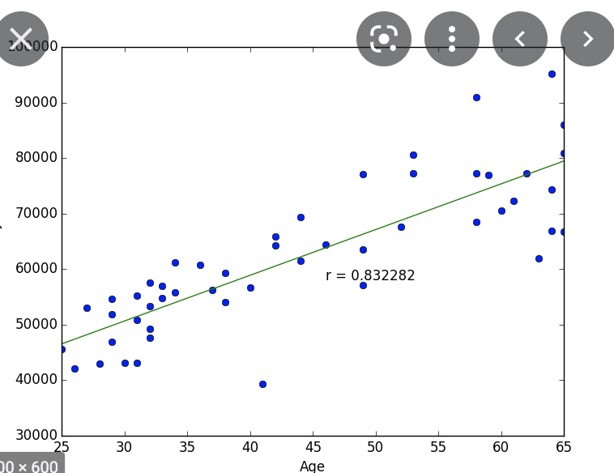
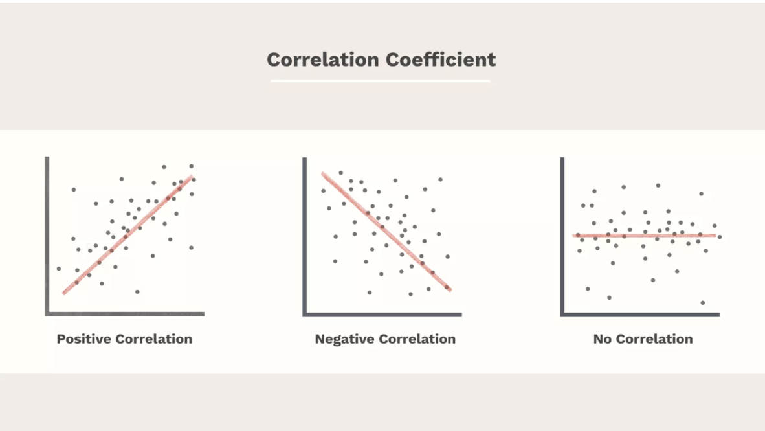
What is correlation
Correlation is a statistical measure that expresses the extent to which two variables are linearly related (meaning they change together at a constant rate). It's a common tool for describing simple relationships without making a statement about cause and effect.

Slide 11
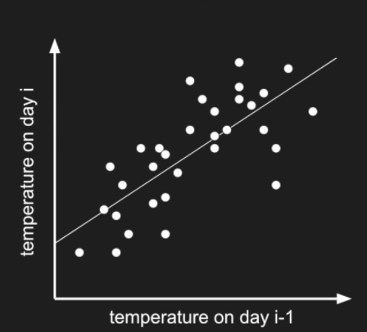
How is correlation different to autocorrelation
Correlation is linear relationship between two variables
Whereas autocorrelation is relationship between variable and itself
In timeseries: Correlation of value at time t -> value at time t-k where k is number of lags

Slide 12
Finally: What is Causation?
Causation indicates that one event is the result of the occurrence of the other event; i.e. there is a causal relationship between the two events. This is also referred to as cause and effect.
Cons:
Hard to validate
Require domain expertise

Slide 13
Approaching Forecasting problem
Step 1: Exploration
Visualisations
Understanding the data
Statistical Validations
Step 2:
Choosing the model
Choosing model parameters
Step 3:
Splitting the data (training and test)
Training the model on the training data
Testing the model with test data
Repeat (number of times) -> go back to step 2 and repeat
Step 4:
Select the final model and final parameters
Train on entire data
Forecast in the future

Slide 14
Lets move on to Jupyter notebook
Get the data from BQ ✅
Explore the data ✅
Run some statistical tests ✅
We will do Auto Arima in Python ✅
We will use BQML (auto Arima) ✅
Split it into Train test
Train and Test the model
We will visualize the results
We will add holiday to the data
And revisualize
Exploring facebook prophet library

Slide 15
Some Resources
Jupyter Notebook
Forecasting course on Udemy
BQML documentation

Slide 16
Summarise
We learnt about what is forecasting
We learnt about why forecasting is important
We learnt key concepts in time series
We learnt how to approach time series forecasting
We learnt about ARIMA modelling in Python

Slide 17
Thank you

